Slide 1
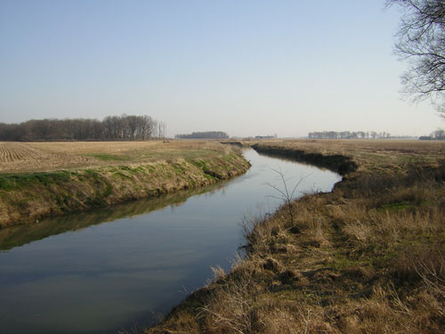
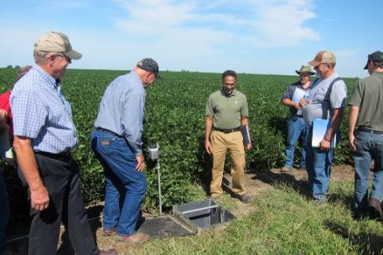
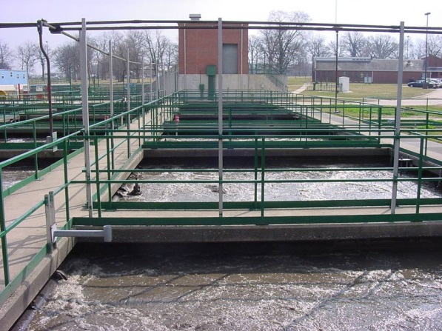
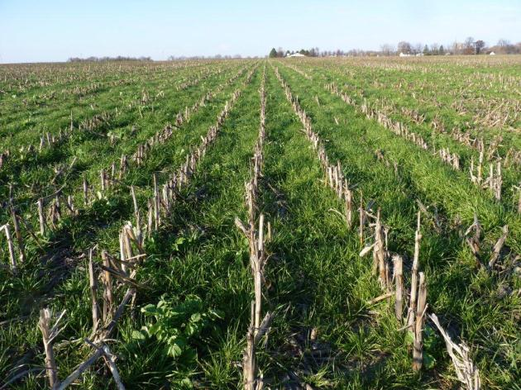
Science Assessment to Support an Illinois Nutrient Reduction Strategy
Mark David, George Czapar,
Greg McIsaac, Corey Mitchell
March 11, 2013
11-08-12

Slide 2
Technical Tasks
develop a science based technical assessment of:
  current conditions in Illinois of nutrient sources and export by rivers in the state from point and non-point sources
  methods that could be used to reduce these losses and estimates of their effectiveness throughout Illinois
  estimates of the costs of statewide and watershed level application of these methods to reduce nutrient losses to meet TMDL and Gulf of Mexico goals

Slide 3
Steps we will take
determine current conditions
identify critical watersheds
estimate potential reductions and costs
develop scenarios

Slide 4
1. Current Conditions
nutrient (nitrate and total P) loads from major river basins of Illinois
  estimates of point and non-point sources
  compare 1980-1996 with 1997-2010
  determine direction of loads
determine current agricultural management practices across the state
  nutrient inputs and management (fertilizers and manure)
  current cropping practices
  P losses from water quality data
  nutrient balances
Notes:
Water is here for a few hours.

Slide 5
N and P Fluxes for State, 1980 to 1997
From David and Gentry (2000)

Slide 6
Annual N Fertilizer Applications
Fertilizer (kg N ha⁻¹)
0.0 - 11.2
11.3 - 27.2
27.3 - 45.4
45.5 - 65.9
66.0 - 107.1
From David et al. (2010)

Slide 7
Tile drainage is concentrated in the corn belt
Fraction of county
From David et al. (2010)

Slide 8
Net N Inputs (NNI)
kg N ha⁻¹
Some counties negative, N from soil mineralization

Slide 9
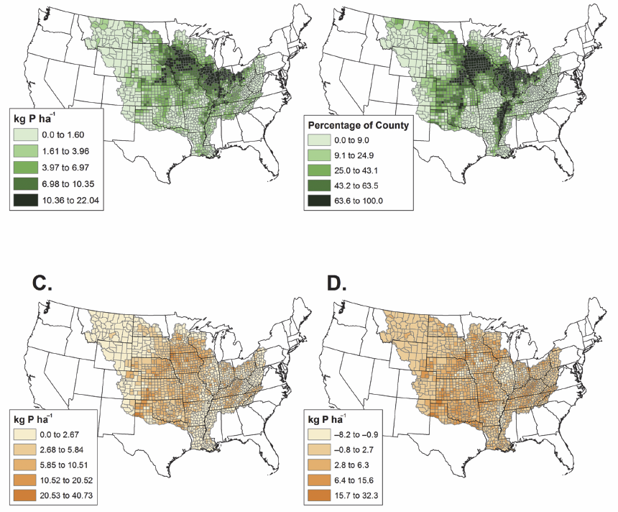
Fertilizer P
Row Crop %
Manure P
Net P Inputs
From Jacobson et al. (2011)

Slide 10
Illinois N budget through 2012

Slide 11
Illinois P budget through 2012

Slide 12
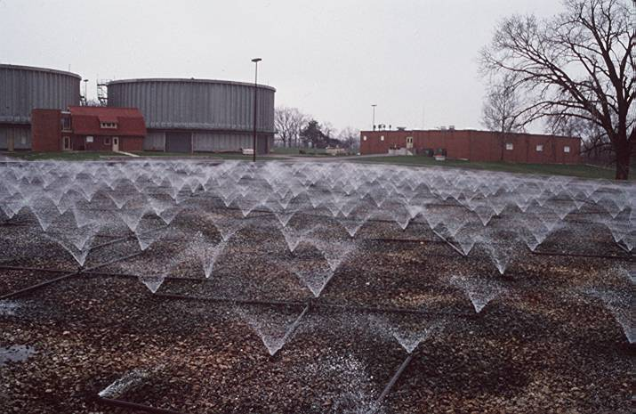
Sewage Effluent -12.9 million people
16% of total N load statewide
21% for Illinois River, 14% for others
47% of total P load statewide
70% for Illinois River, 33% for others
From David and Gentry (2000)

Slide 13
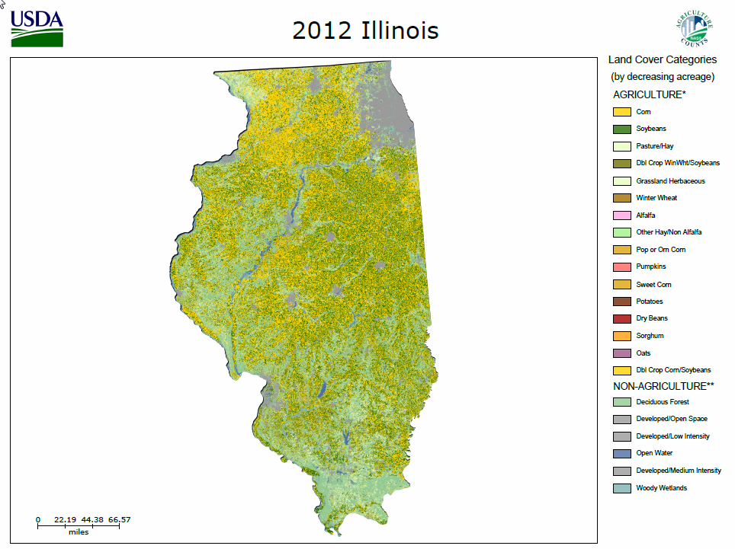

Slide 14
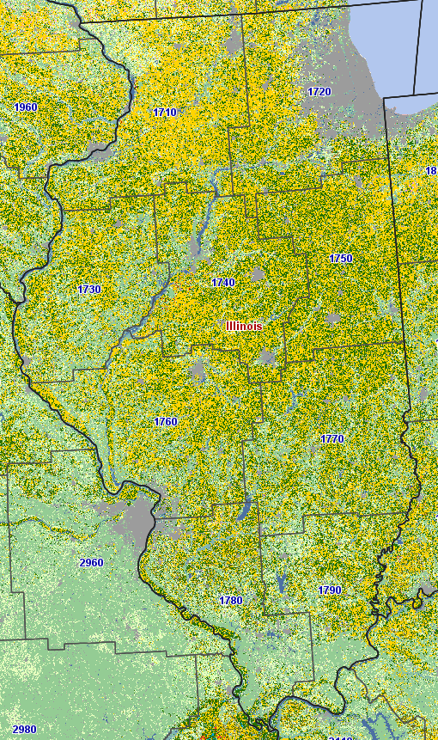
Crop Reporting Districts

Slide 15
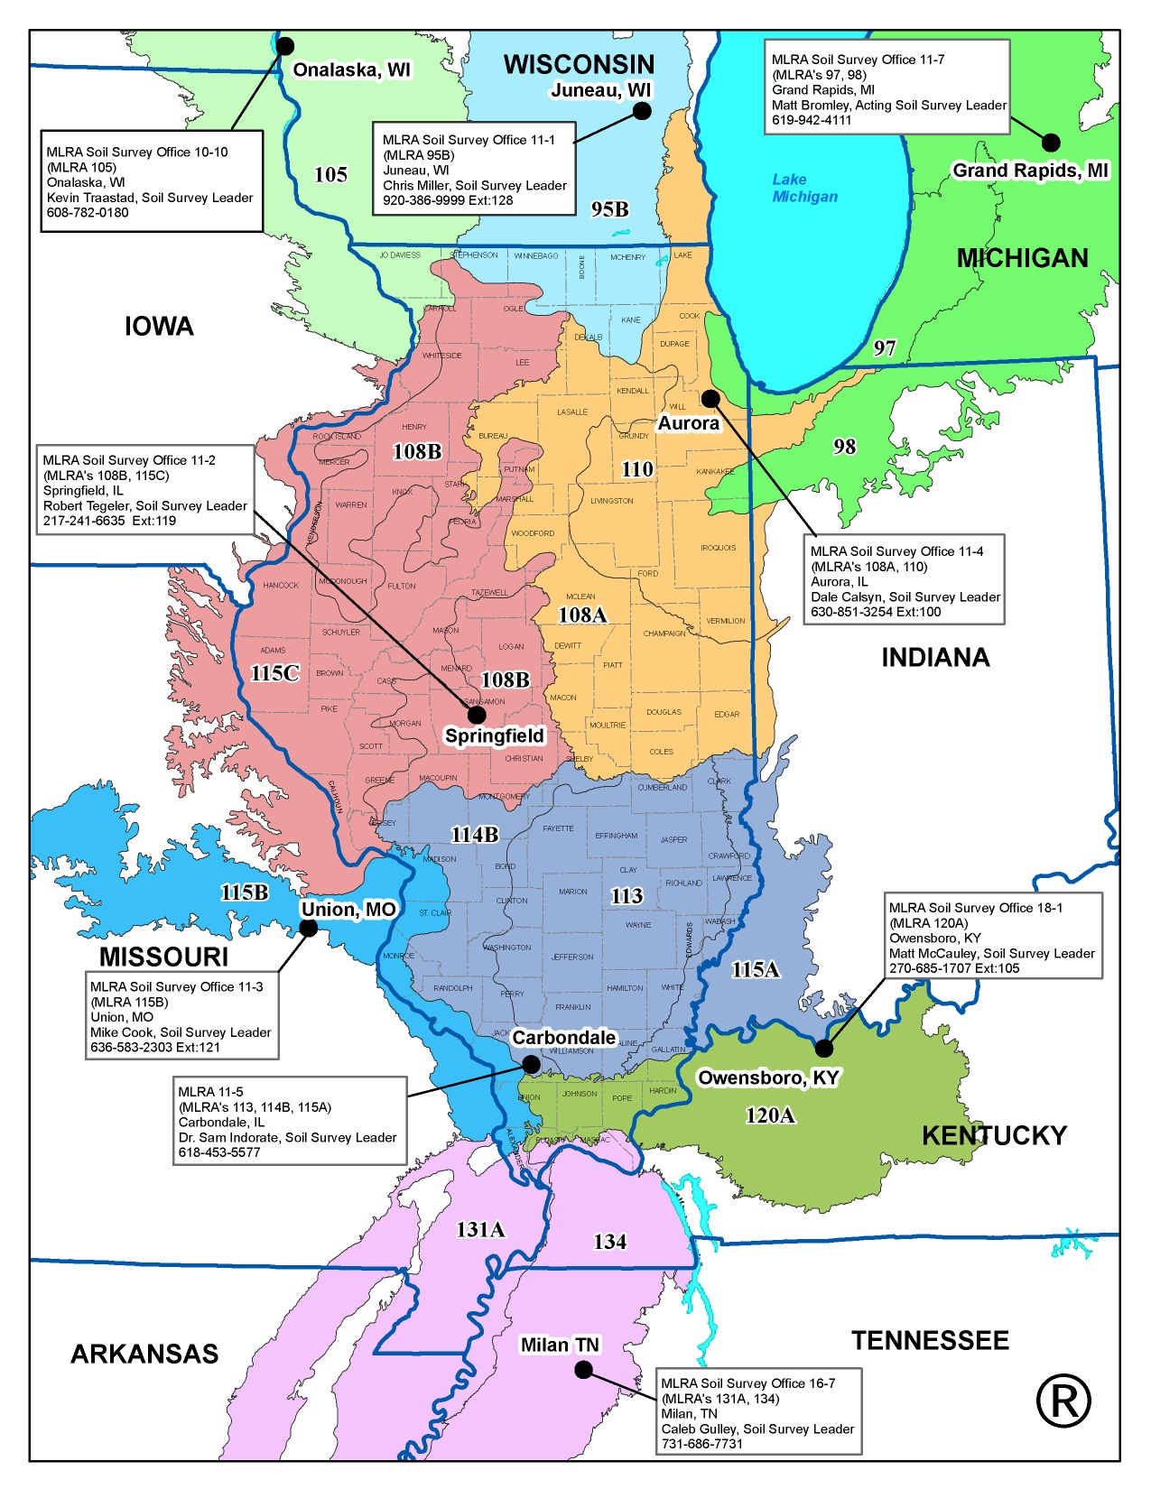
Illinois MLRAs

Slide 16
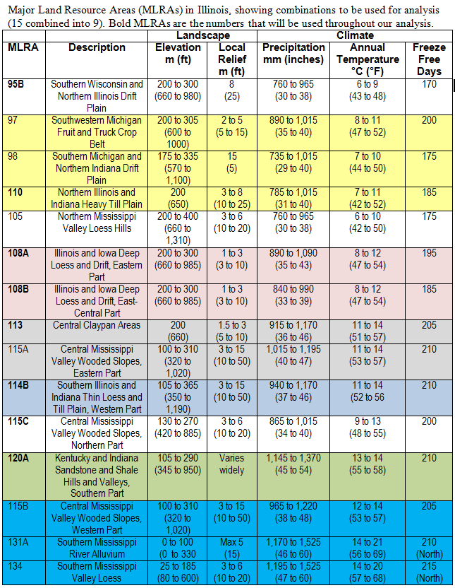
Combined MLRA’s

Slide 17
2. Critical Watershed Identification
identify 8 digits HUCs with the highest nutrient yields and loads to the Gulf of Mexico
identify watersheds with nutrient impaired water bodies (303d list)
determine overlap
estimate point and non-point sources of N and P within watersheds

Slide 18
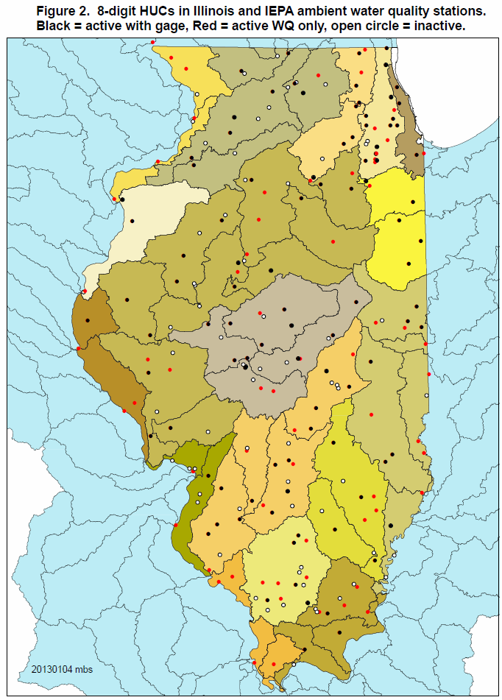

Slide 19
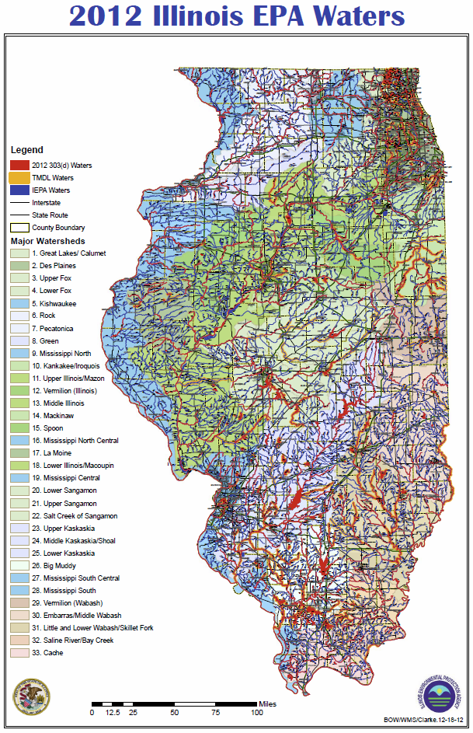

Slide 20
January to June Nitrate-N Yield
Adapted from David et al. (2010)

Slide 21
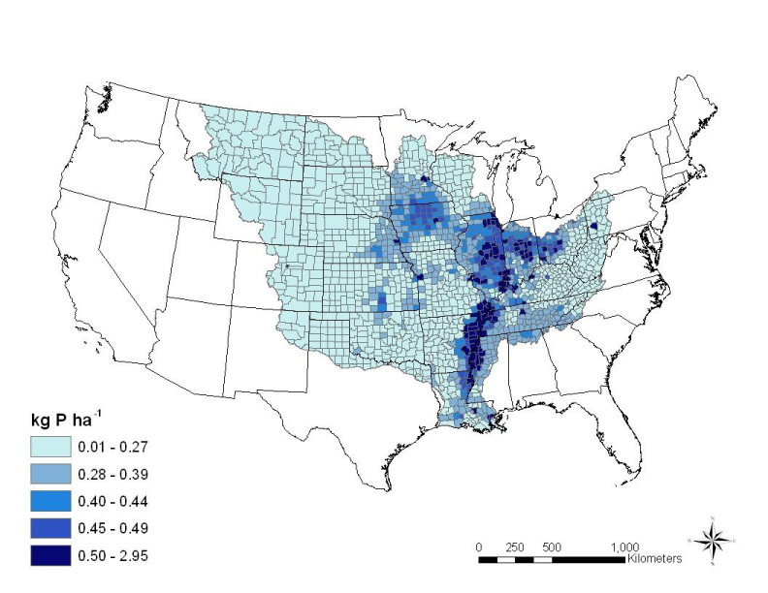
Modeled January to June Total P
From Jacobson et al. (2011)

Slide 22
3. Estimate Potential Reductions and Costs
estimate field-level effectiveness of various agricultural management practices
  utilize SAB, Iowa, and Lake Bloomington Project estimates
  involve scientific panel from throughout the state
determine possible point source reductions
estimate costs
  agricultural economist will lead
  initial investments
  annualized costs over 25 years

Slide 23
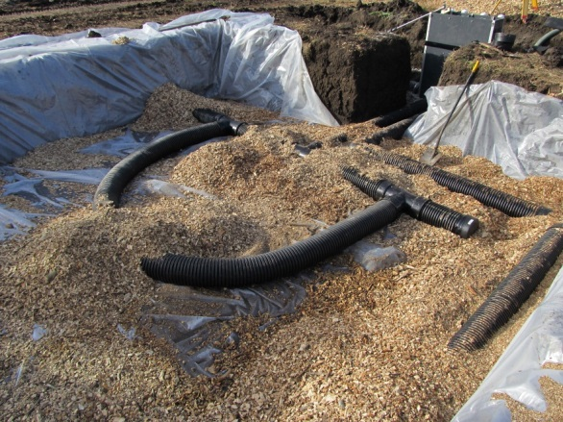
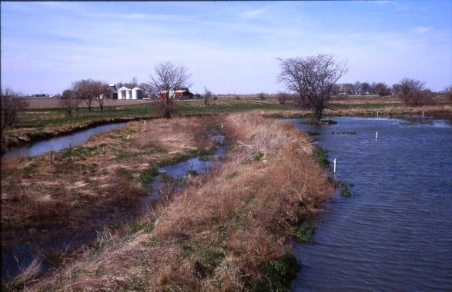
Nitrogen reduction practices
in-field
  rate, source, time of application
  nitrification inhibitor
  cover crops
edge-of-field
  drainage water management
  wetlands, bioreactors, buffers
land use
  extended rotations
  land retirement: pasture, energy crops, perennials

Slide 24
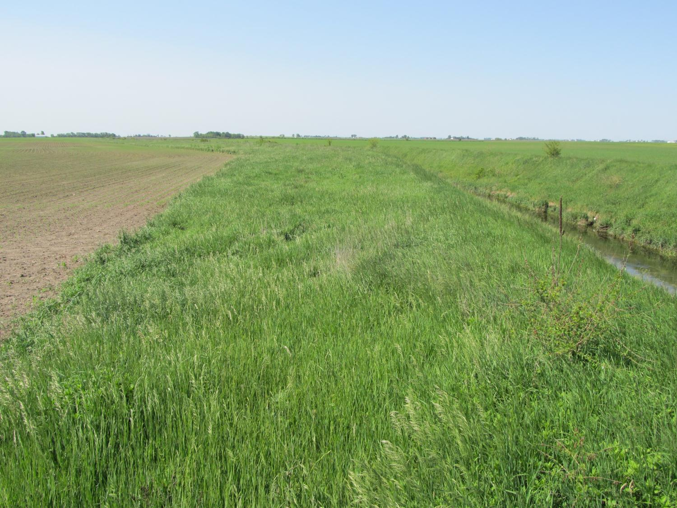
Phosphorus Reduction Practices
in-field
  rate and source of application
  incorporation and tillage
  cover crops
edge-of-field
  buffers
land use
  extended rotations
  land retirement: pasture, energy crops, perennials

Slide 25
4. Develop Scenarios
combine possible point source reductions and field level agricultural reductions
  percent reduction by practice
  costs of implementation
  target 45% reductions in N and P
scale-up to critical watersheds and statewide
provide a range of scenarios to meet reduction targets
  area needed by practice
  initial investment and annualized costs

Slide 26
Questions, comments?

